Slide 1


Event Organizers
[Web Application]
Group No :- 56
Presented By :-
Patel Dhruv R. (6171)
Patel Dev S. (6169)
Patel Kenil D. ()
Soni Anant R. (6331)
Guided by :- Prof. Khushboo D Patel
1

Slide 2
Personal Profile
Exam No | 6171
Name | Patel Dhruv R.
Address | Amroli, Surat
Email Address | rajsavsaiya20@gmail.com
Phone no | +91 90169 02887
Exam No | 3196
Name | Patel Kenil T.
Address | Olpad, Surat
Email Address | rajsavsaiya20@gmail.com
Phone no | +91 70969 90475
Exam No | 6169
Name | Patel Dev S.
Address | Adajan, Surat
Email Address | dhavalvekariya05@gmail.com
Phone no | +91 94297 10212
Exam No | 6331
Name | Soni Anant R.
Address | Katargam, Surat
Email Address | dhavalvekariya05@gmail.com
Phone no | +91 81405 91020
2

Slide 3
Overview :
Bibliography
Conclusion
workflow
introduction
Scope and Planning
Designing
Scope and Planning
3

Slide 4

Introduction
Welcome To
Our event organizers' website is a comprehensive platform designed to streamline the process of planning and executing events of any scale. With a user-friendly interface, it offers an array of features including event creation tools, venue selection assistance, vendor management systems, attendee registration and ticketing solutions, and customizable event websites. Through seamless integration with social media platforms, our website maximizes event exposure and engagement. Additionally, robust analytics tools provide organizers with valuable insights into attendee demographics and event performance, enabling informed decision-making for future events.
Event Organizers
4

Slide 5


WORK FLOW
Manage Transactions
Book Event Form
Add By User
Admin
Other User
Manage gallery
View client data
Email & Contact No.
Date & Time
View login data
View user messages
Place Details
View register data
view feedback and rating
Manager Details
Payment Transactions
5
5

Slide 6
Scope & Planning :
Requirement Analysis
Feasibility Study
Timeline Chart
Future Development
Technology Details
6

Slide 7
Designing :
Data Flow Diagram
Use Case Diagram
Document Data Model Diagram
Database Design
User Interface
7

Slide 8
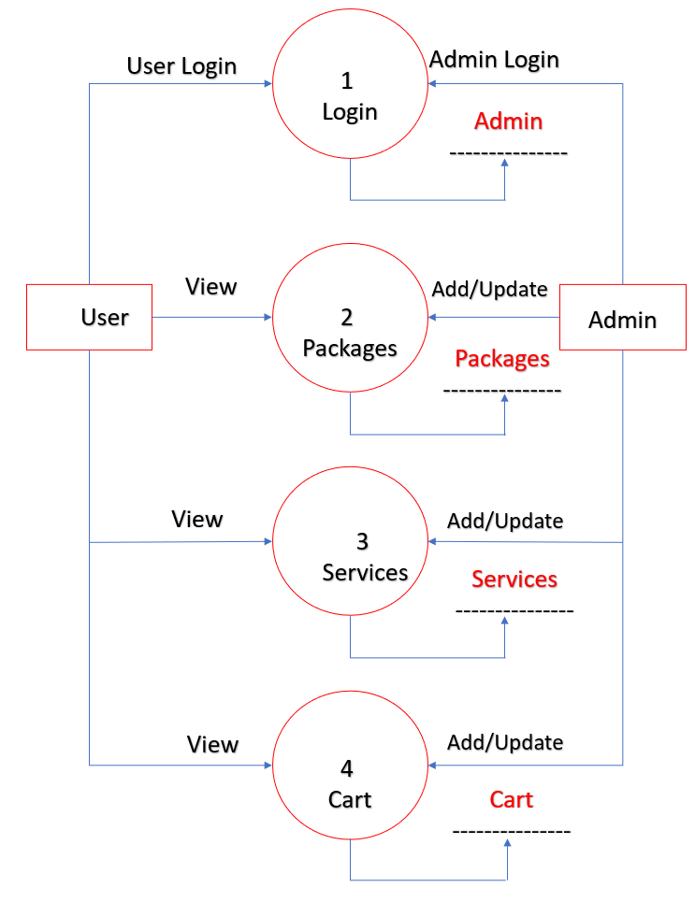
DATA FLOW DIAGRAM
8

Slide 9
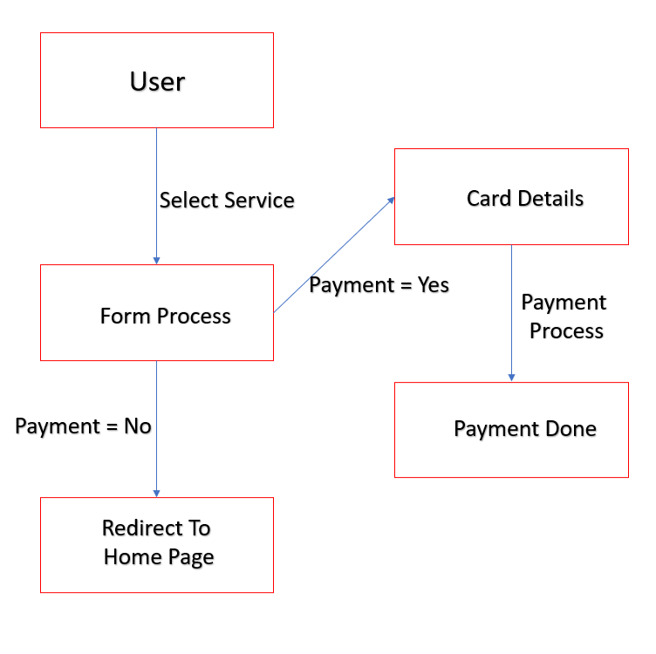
USE CASE DIAGRAM
9

Slide 10
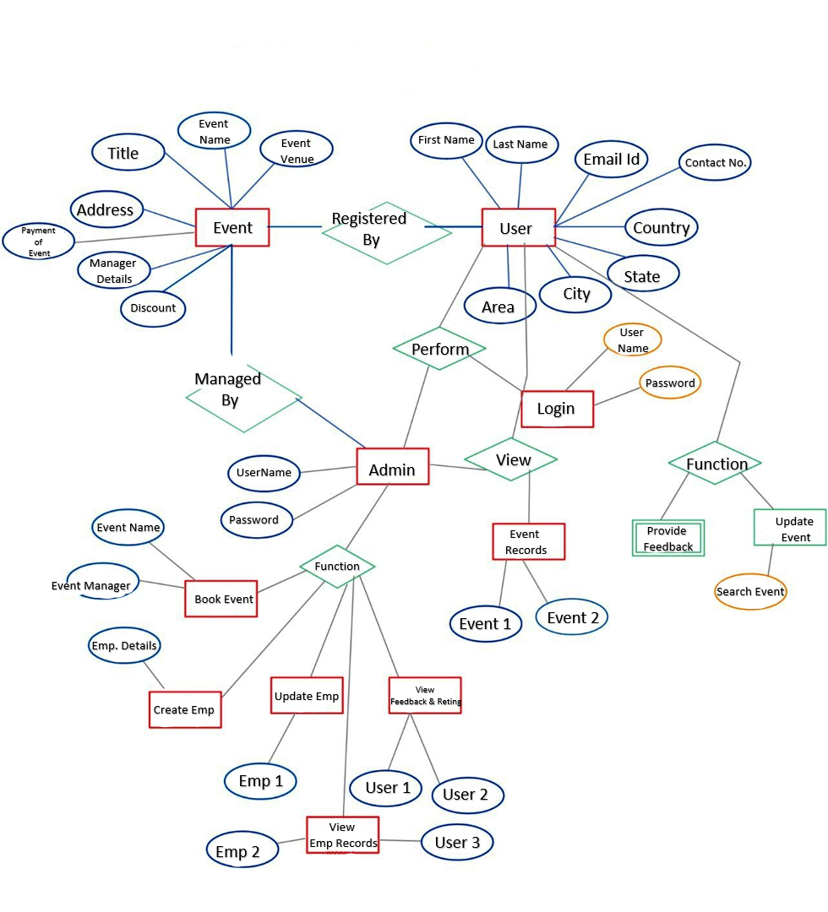
Database Design
10

Slide 11
USER INTERFACE
Payment Process
Date & time
User Side Interface
Admin Side Interface
Email & Contact
11

Slide 12
Testing :
UNIT TESTING
NAVIGATION TESTING
FUNCTIONAL TESTING
ENVIRONMENT TESTING
12

Slide 13
Bibliography
Reference Links:
https://youtu.be/LgMbITJUdM0?si=VrSjVj34Xf2PZqUG
https://youtu.be/jRq0NWlEw50?si=9ALL2ROOhNytb3Yl
https://youtu.be/SCi-BNgRIhY?si=CeFcnCQD9ETkxOT9
https://youtu.be/iEasMXu72No?si=fj5AlaMaeULzWl4B
https://youtu.be/r6JqSA2RQPE?si=HfNquSaw5CnYQ0os
https://codedesign.co/top-10-event-planning-websites/
https://colorlib.com/wp/event-planner-websites/
https://www.v3events.in/
13

Slide 14
Thank You

